Slide 1

Οι σημαντικότερες δημοσιεύσεις πάνω στην αντιμετώπιση της στυτικής δυσλειτουργίας τον τελευταίο χρόνο
Χαράλαμπος Κωνσταντινίδης, MD, FEBU, FECSM
Εθνικό Κέντρο Αποκατάστασης

Slide 2
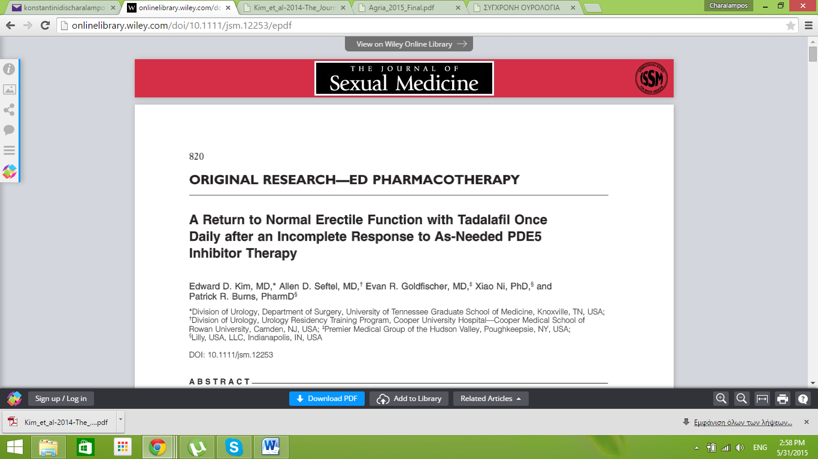
J Sex Med 2014;11:820–830

Slide 3
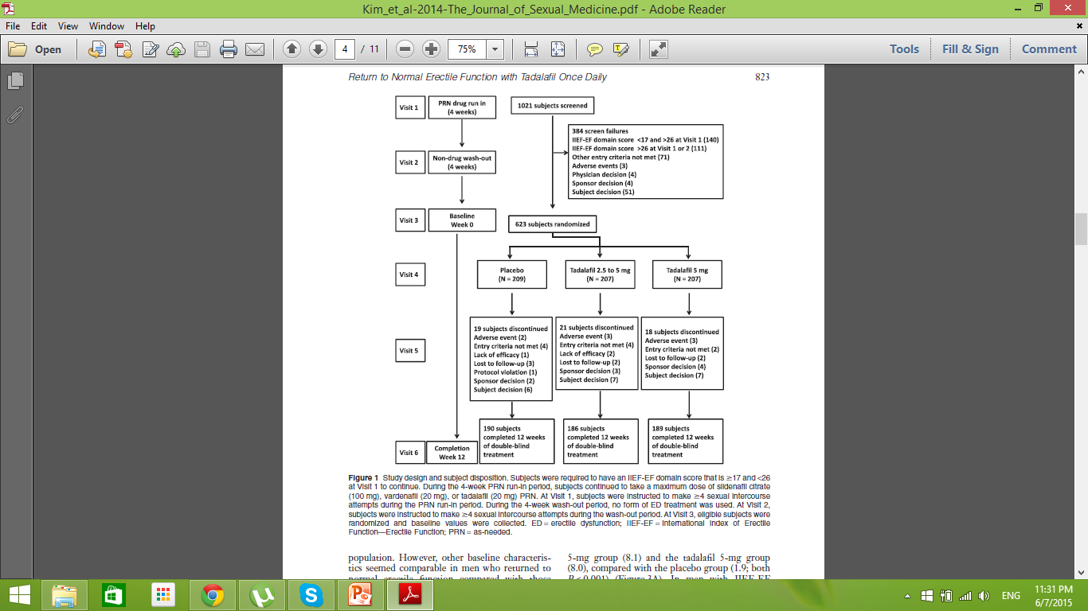

Slide 4
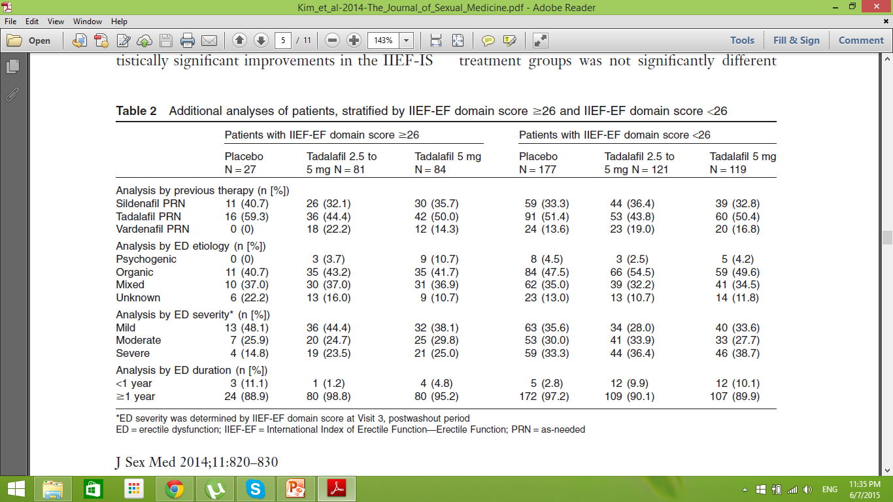

Slide 5
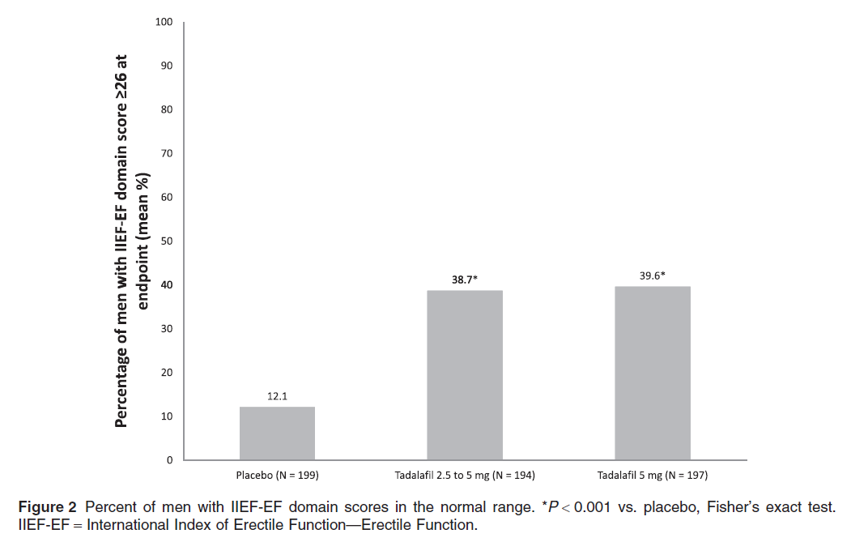

Slide 6
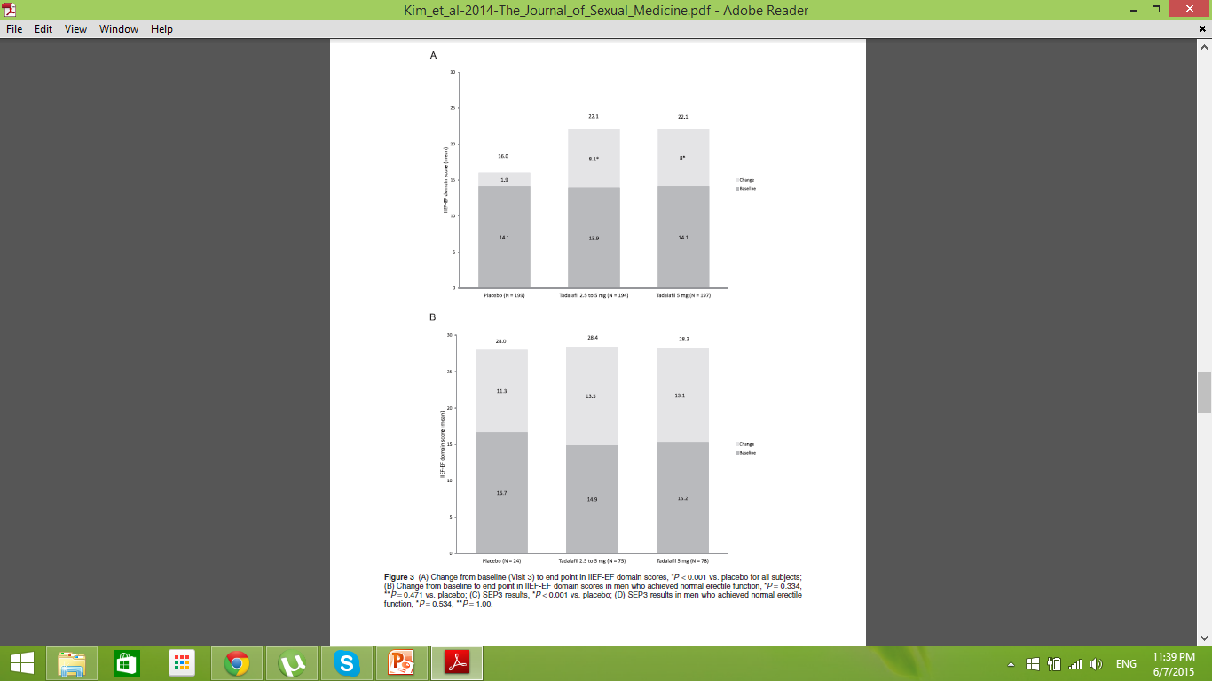
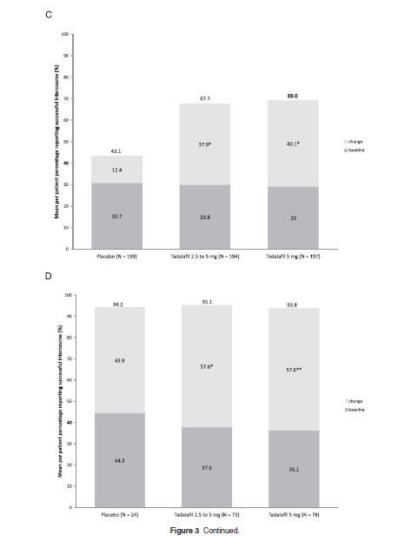

Slide 7
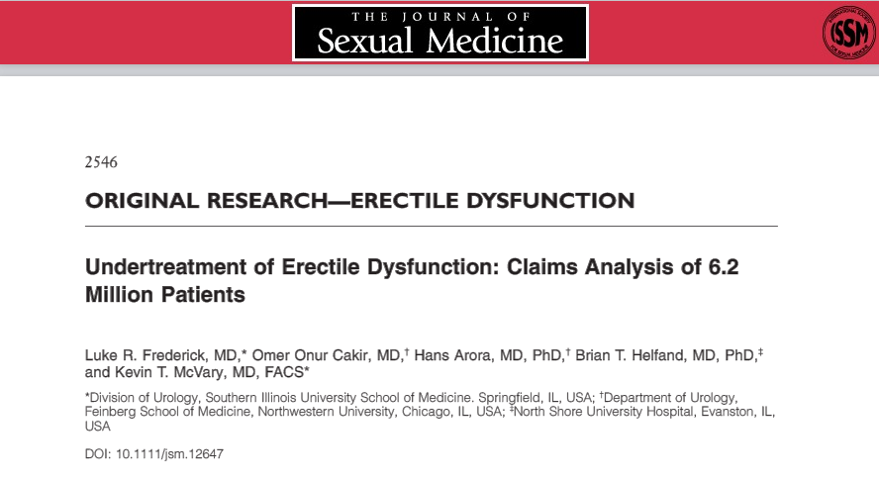
J Sex Med 2014;11:2546–2553

Slide 8
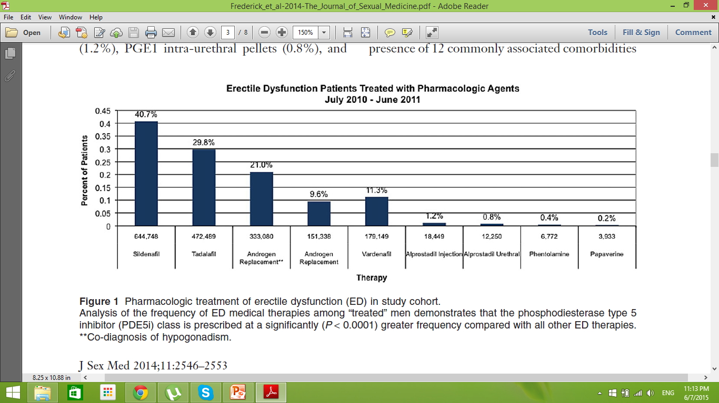

Slide 9
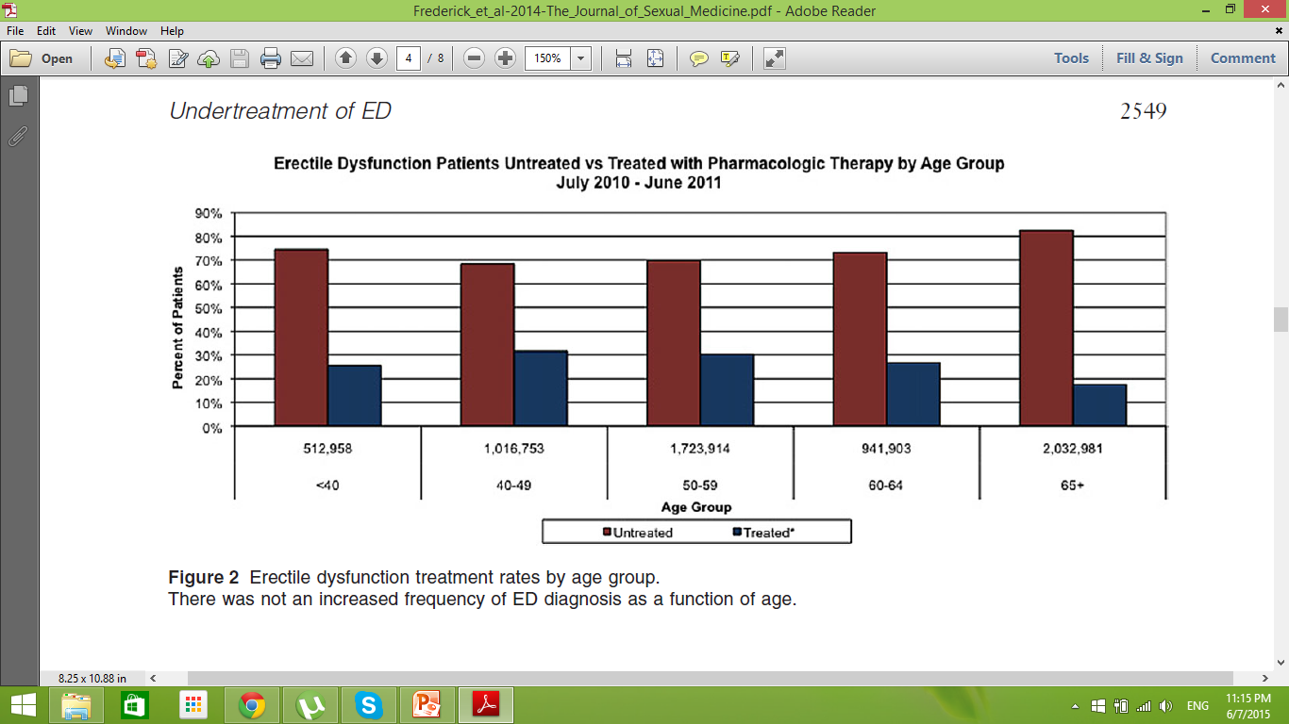

Slide 10
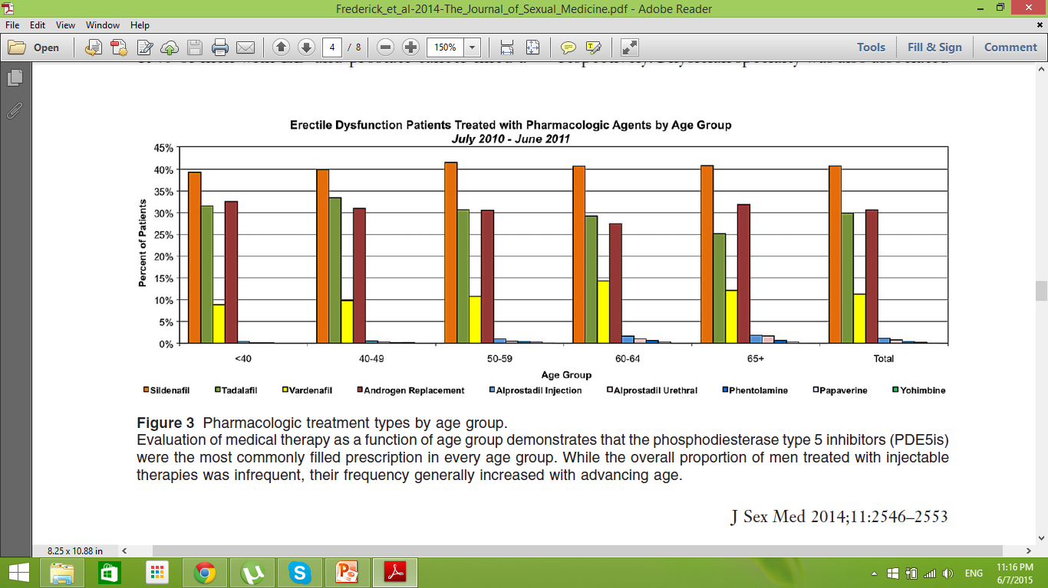

Slide 11
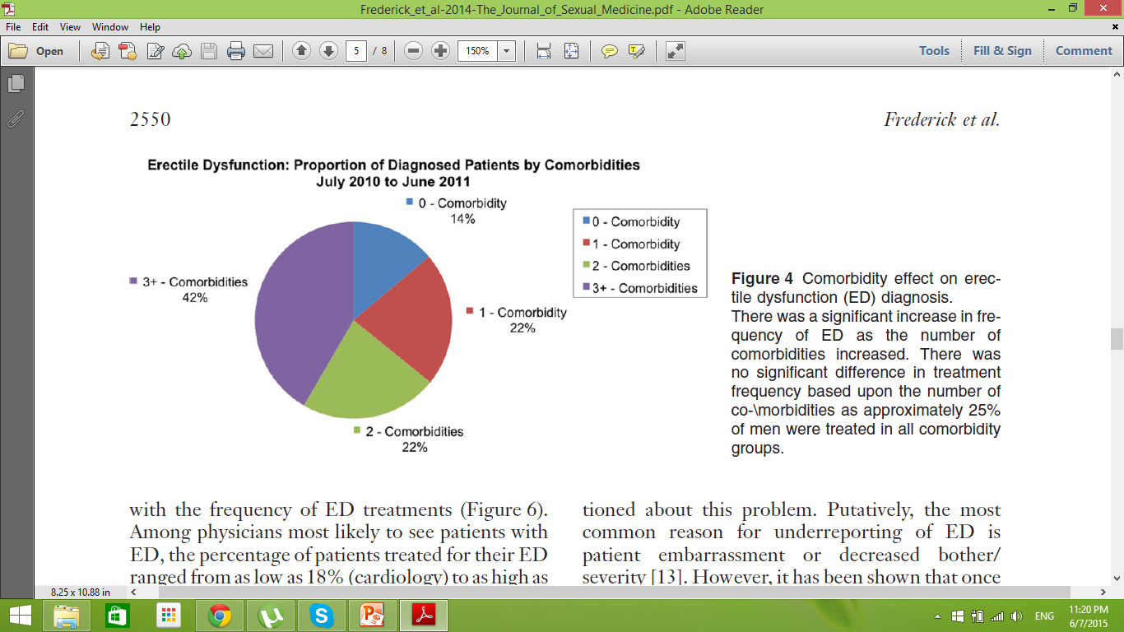

Slide 12
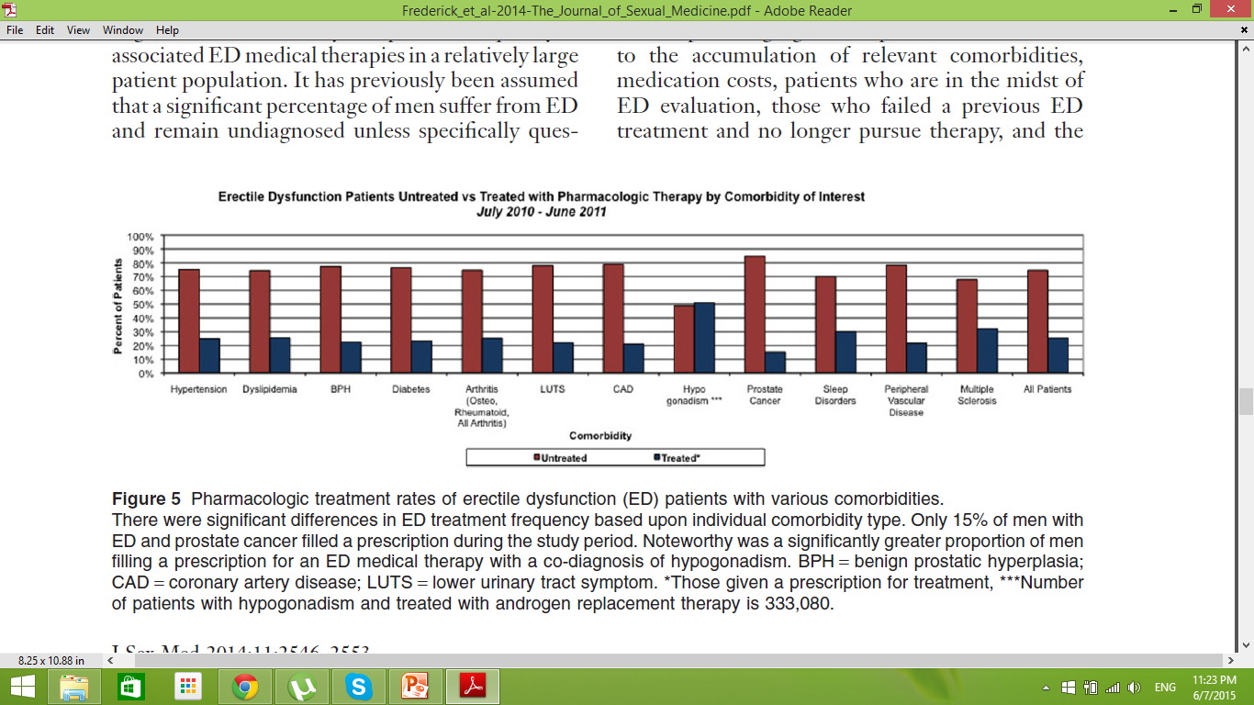

Slide 13
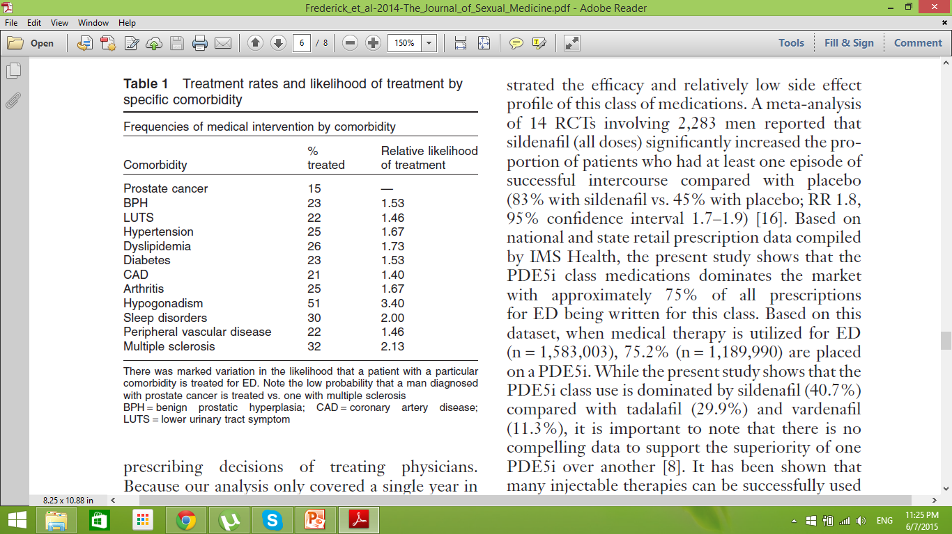

Slide 14
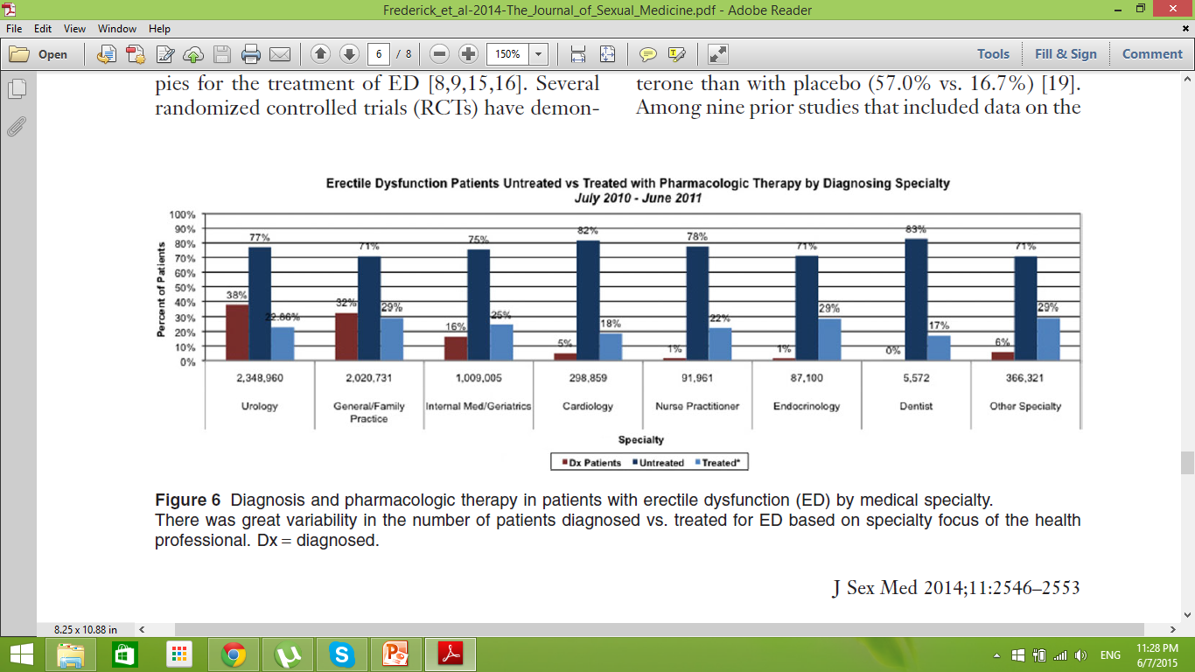

Slide 15
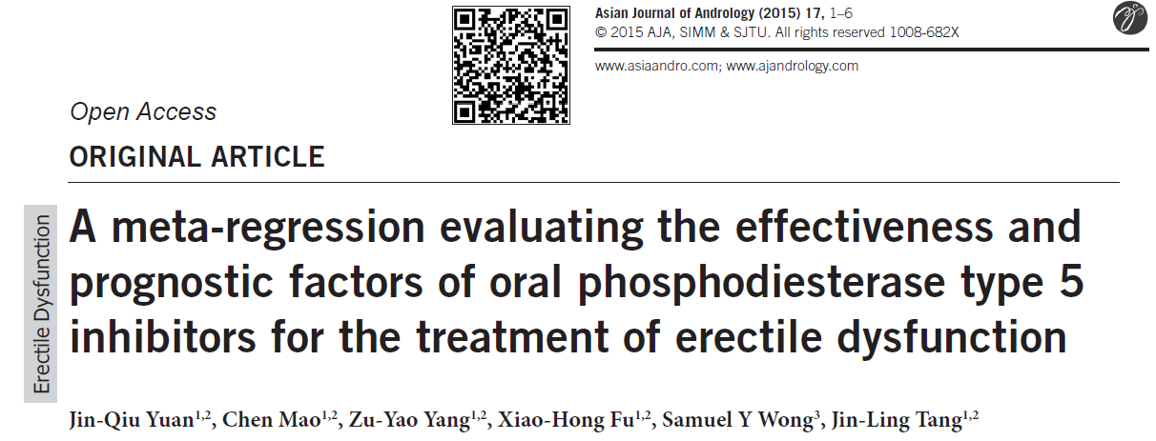
Asian Journal of Andrology (2015) 17, 1–6; doi: 10.4103/1008-682X.154304; published online: 11 May 2015

Slide 16
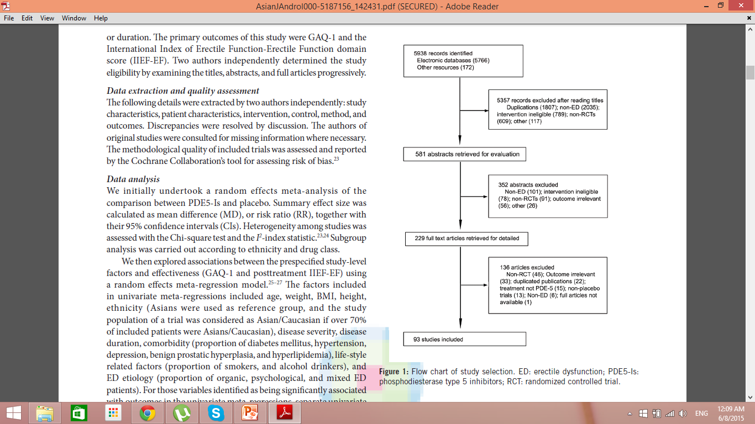

Slide 17
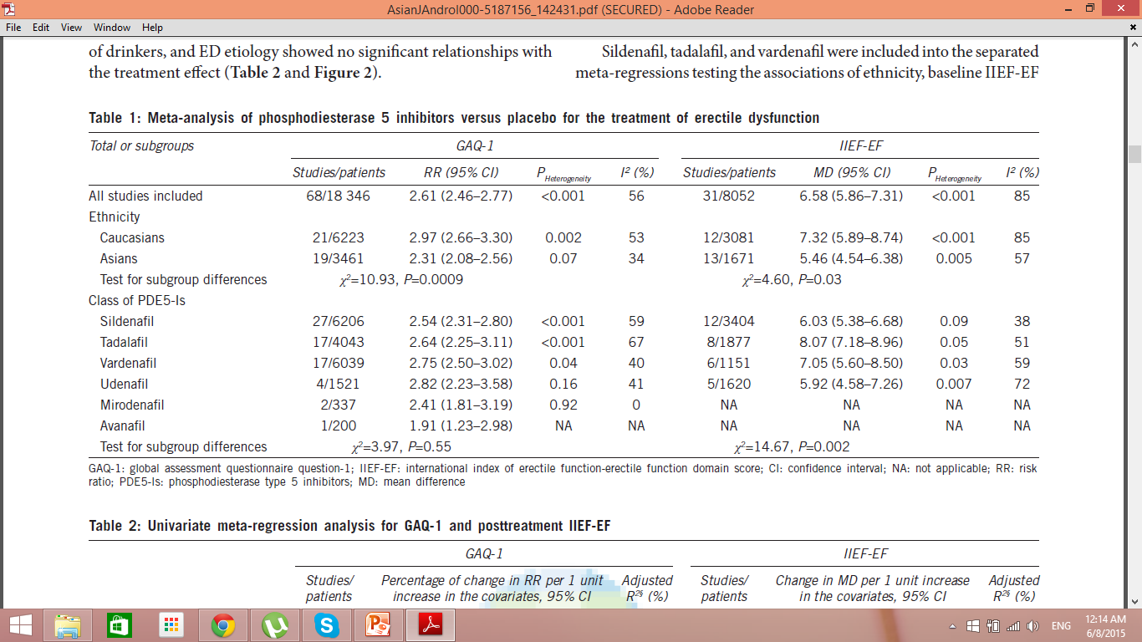

Slide 18
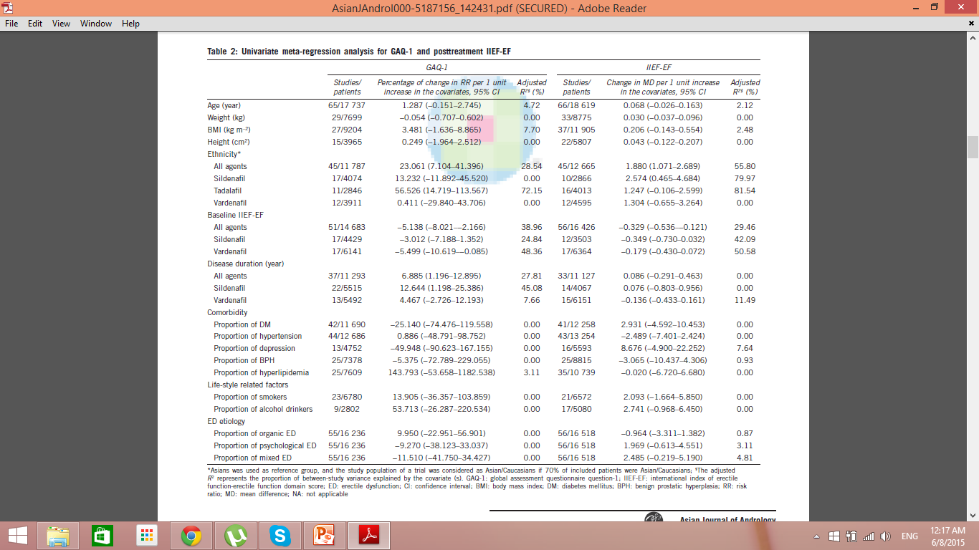

Slide 19
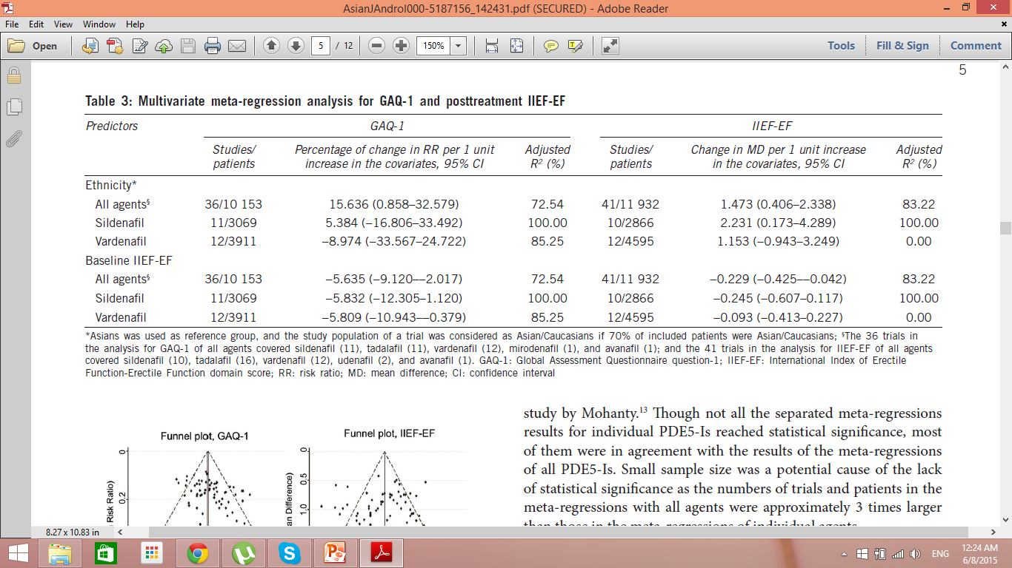

Slide 20
CONCLUSION
PDE5‑Is, on the whole, appear more effective in Caucasians than in Asians, and in severe ED patients than mild ED patients.
For individual PDE5‑Is, these relationships still exist though they do not always reach statistical significance.
Age, weight, BMI, height, comorbidity, smoking, alcohol consumption, and ED etiology appear not to be associated with the effectiveness of PED5‑Is based on trial‑level data.

Slide 21
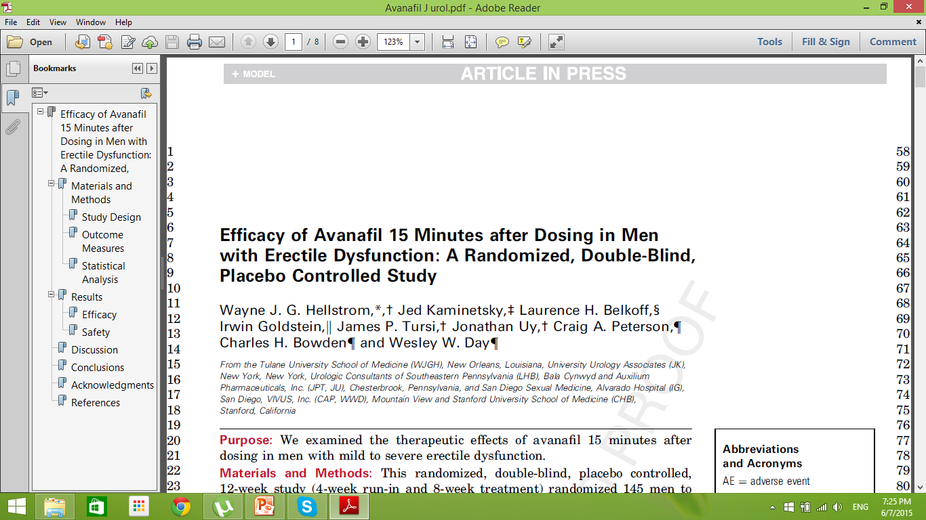
0022-5347/15/1942-0001/0
THE JOURNAL OF UROLOGY®
2015 by AMERICAN UROLOGICAL ASSOCIATION EDUCATION AND RESEARCH, INC.
http://dx.doi.org/10.1016/j.juro.2014.12.101
Vol. 194, 1-8, August 2015
Printed in U.S.A.

Slide 22
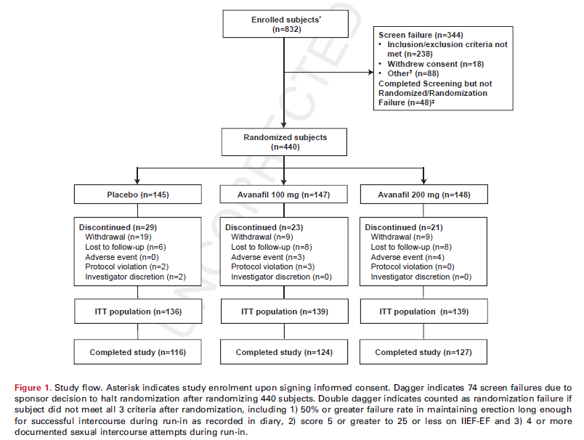

Slide 23
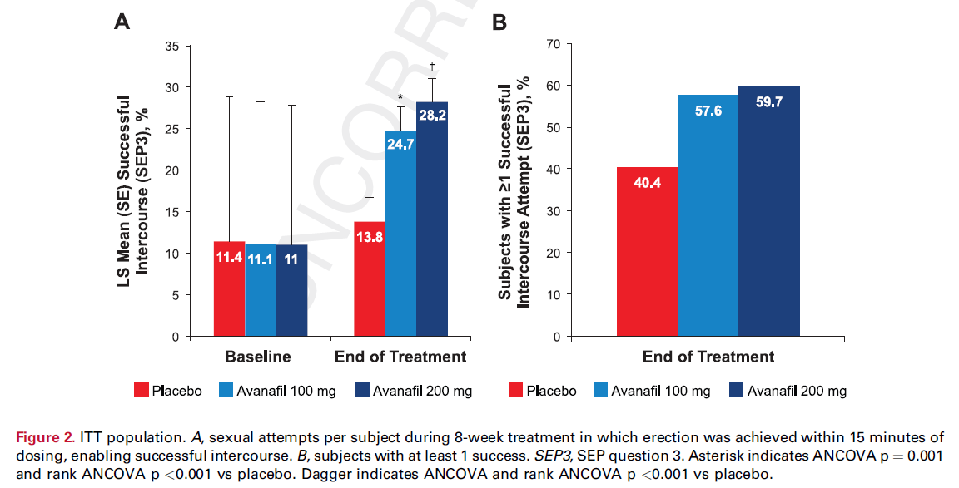

Slide 24
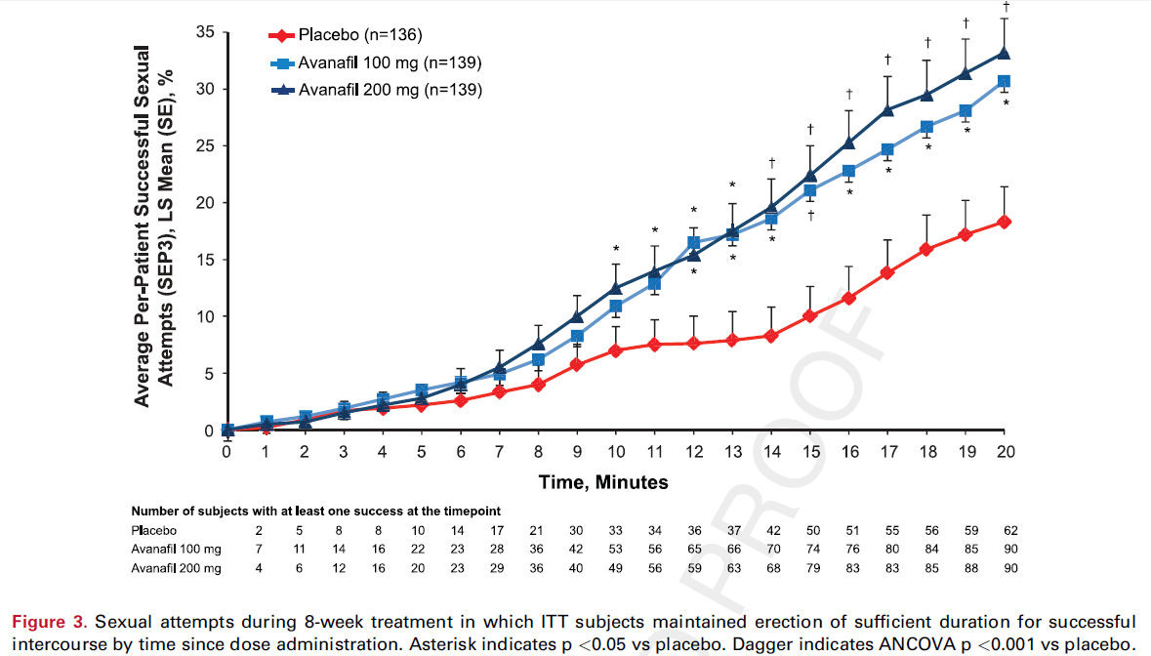

Slide 25
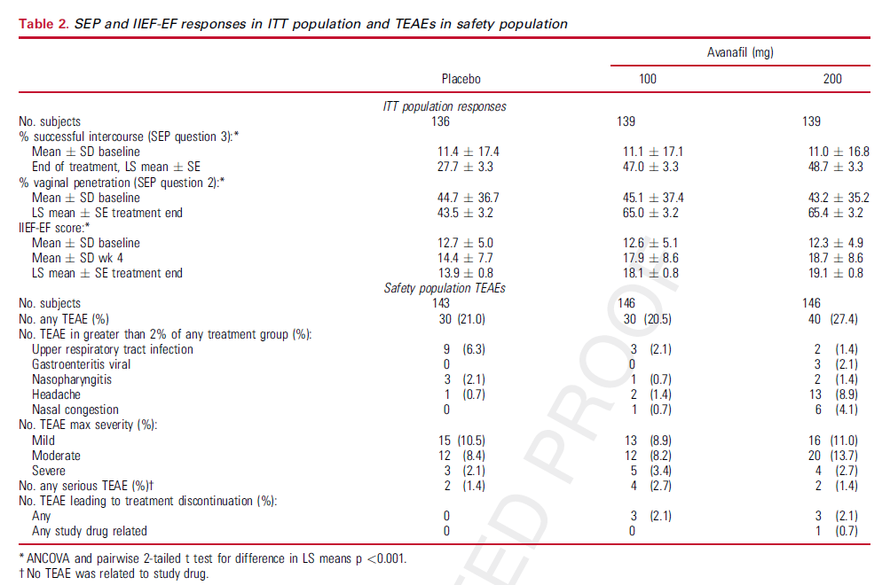

Slide 26
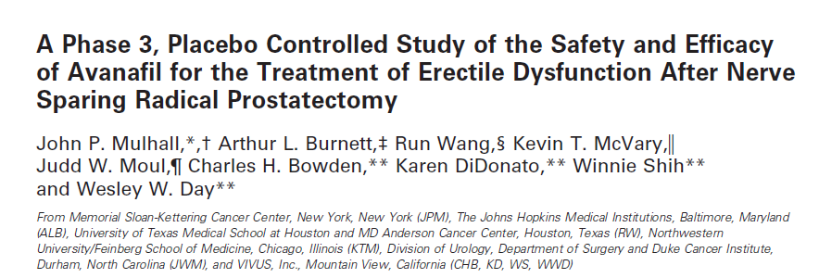
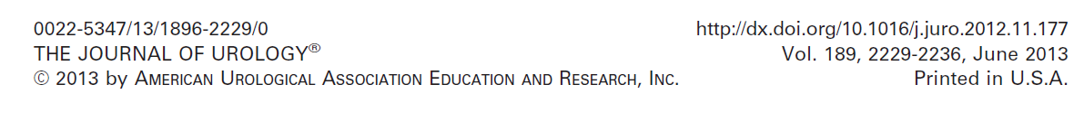

Slide 28
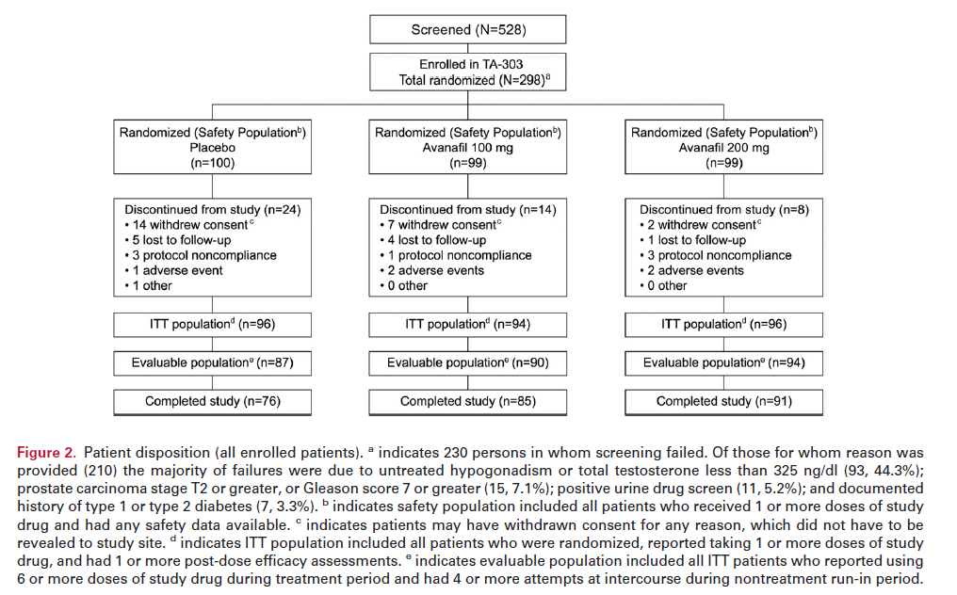

Slide 29
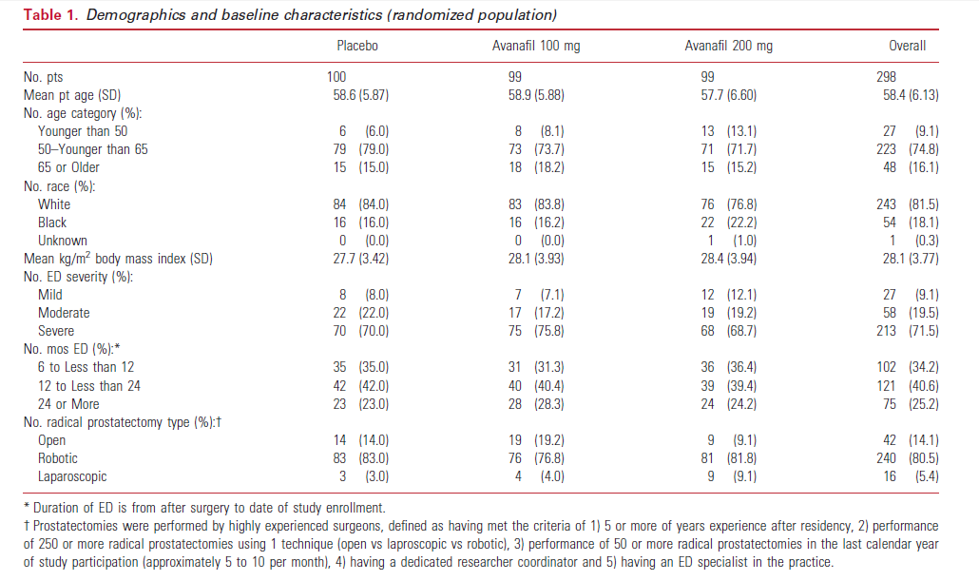

Slide 30
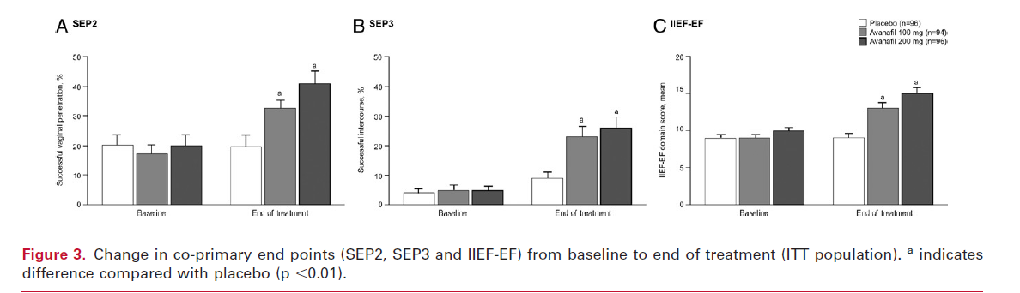
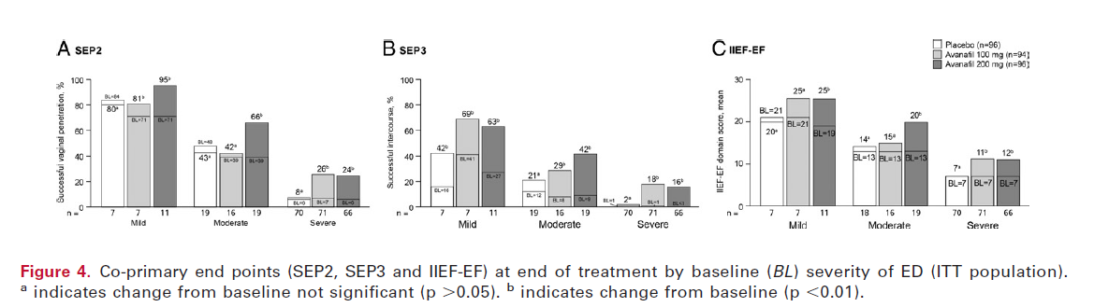

Slide 31
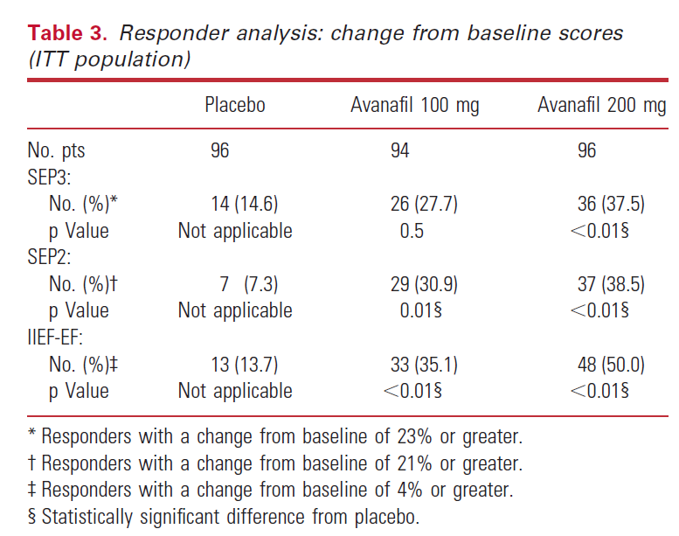

Slide 32
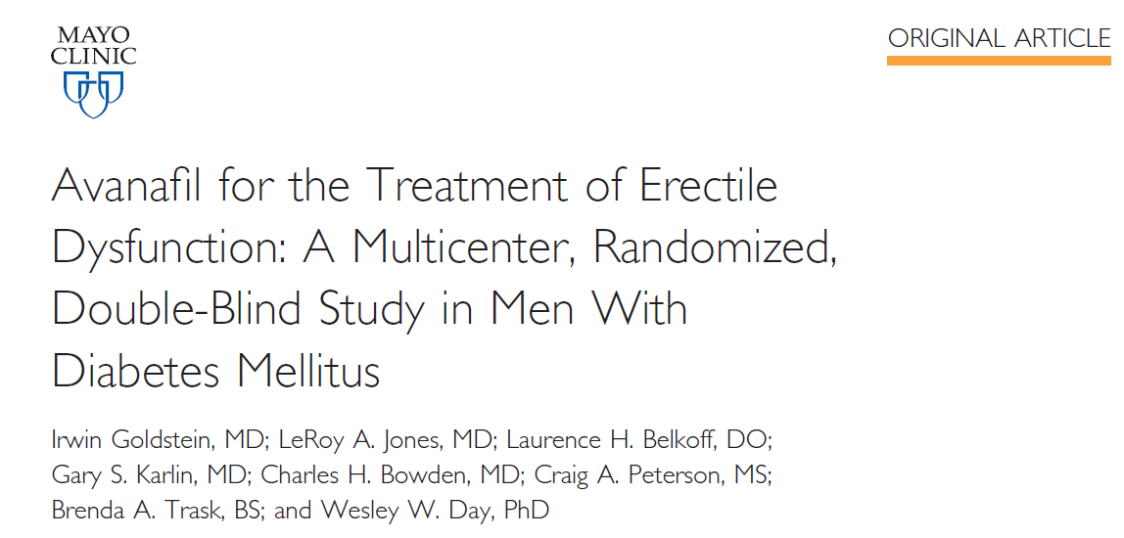
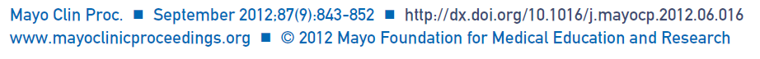

Slide 33
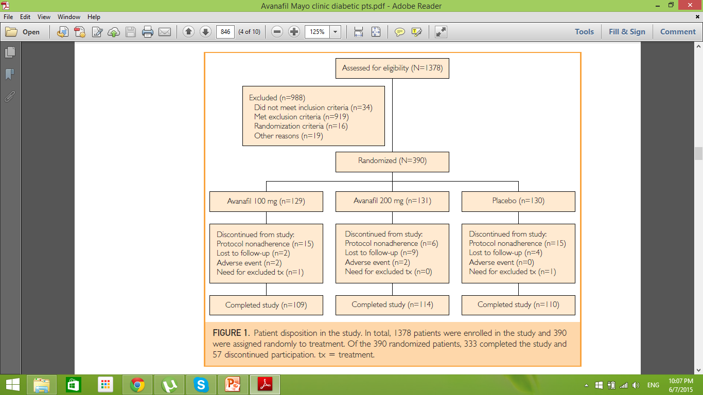

Slide 34
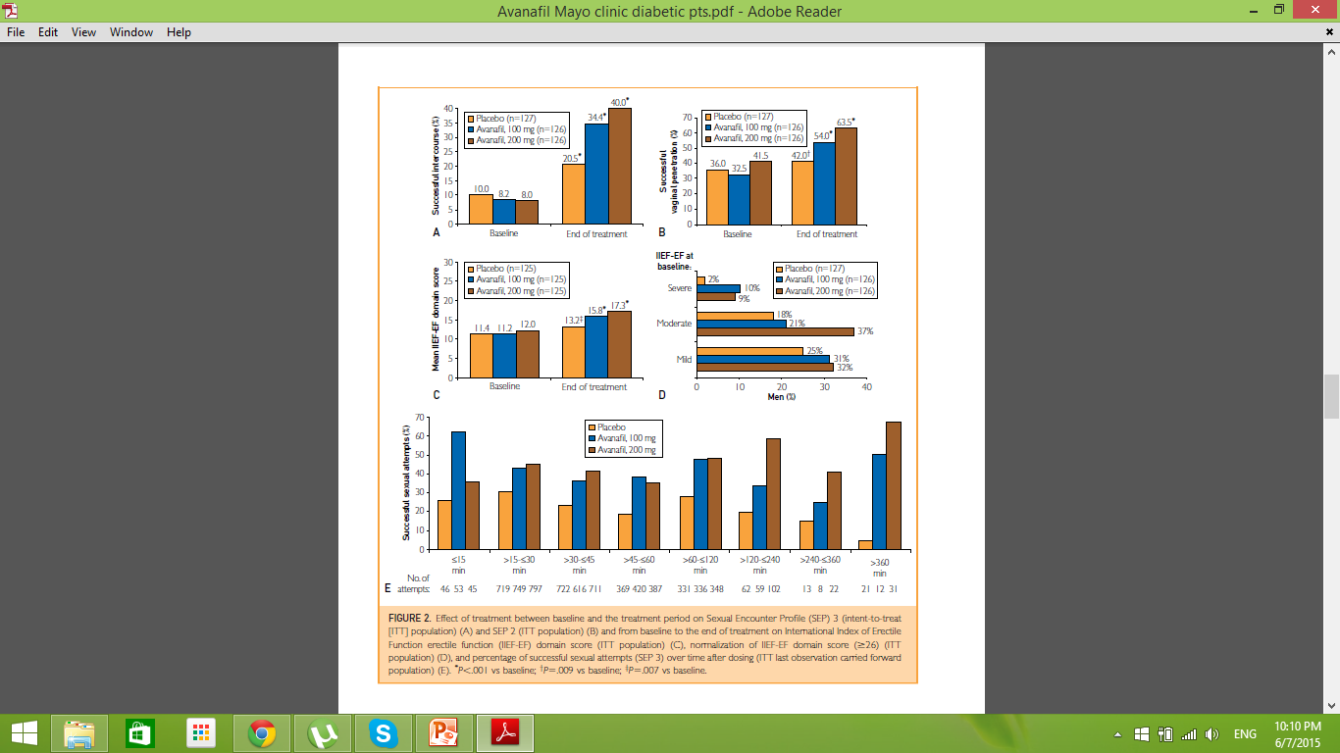

Slide 35
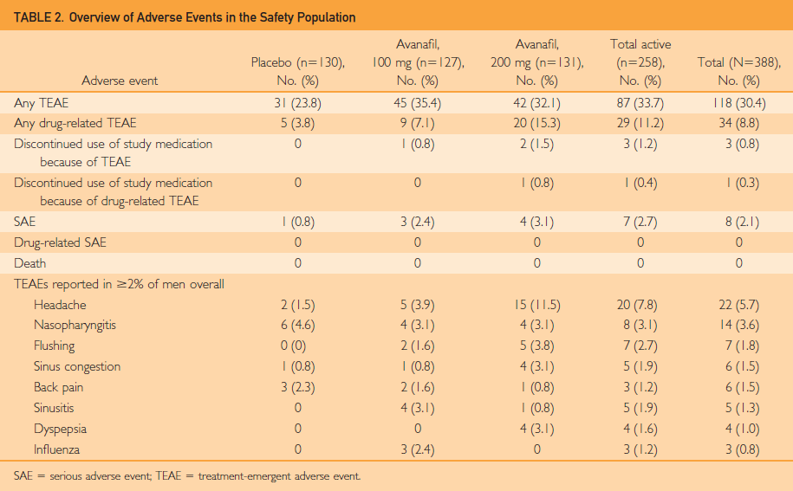

Slide 36
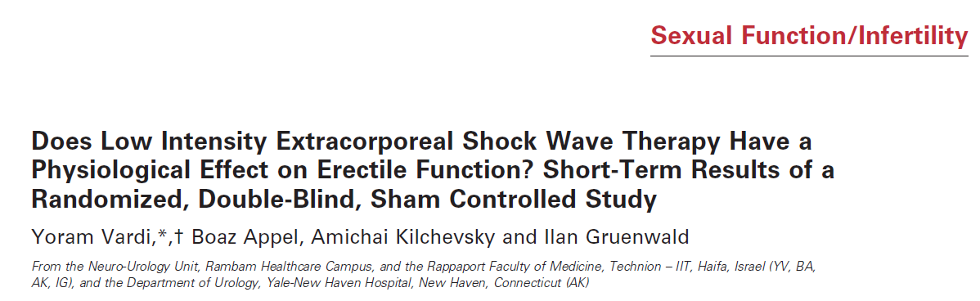
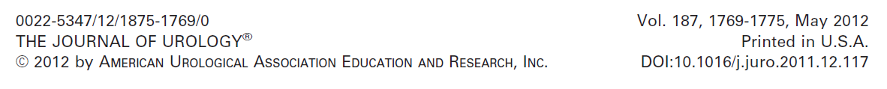

Slide 37
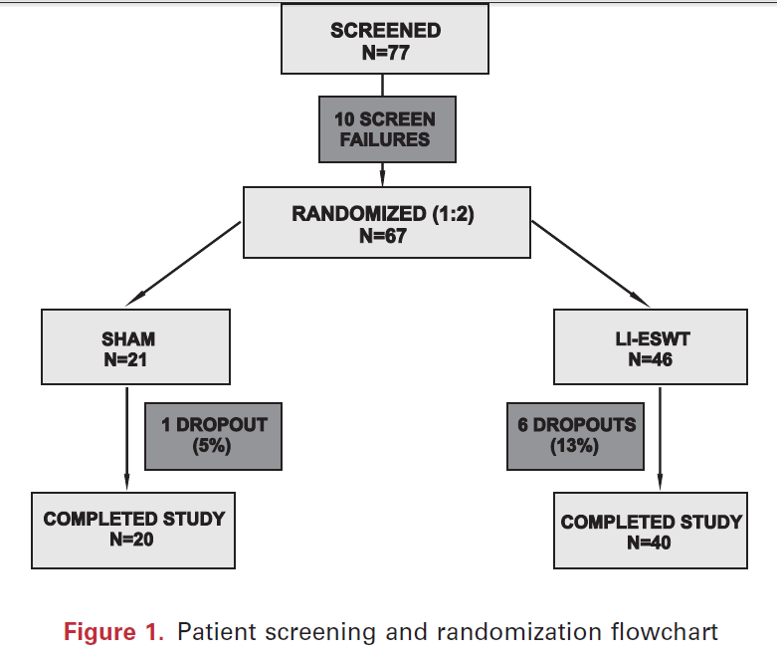

Slide 38
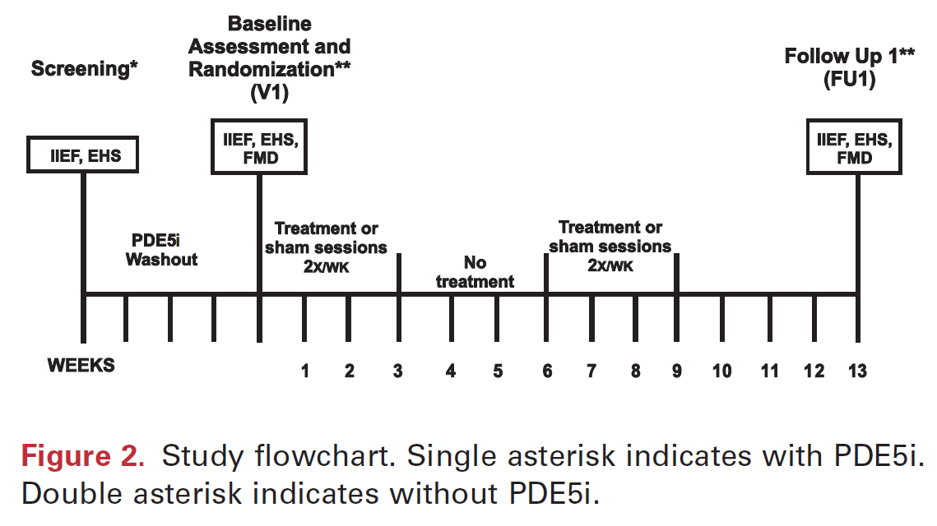

Slide 39
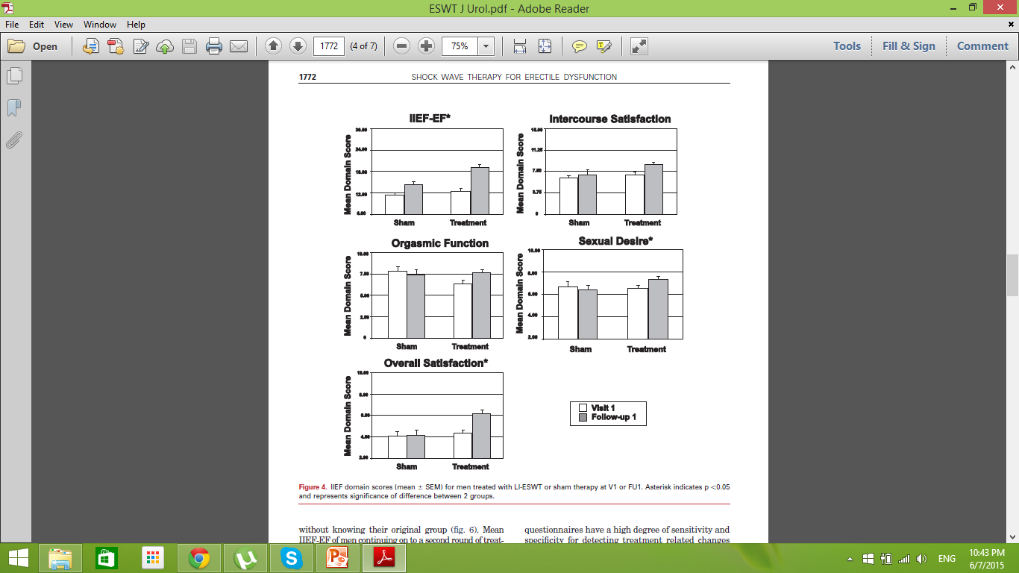

Slide 40
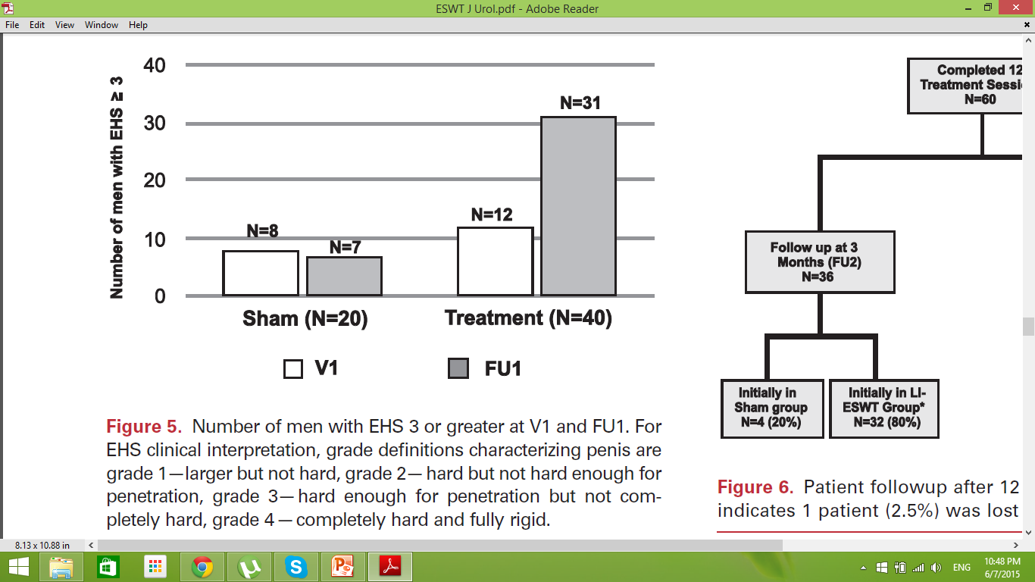

Slide 41
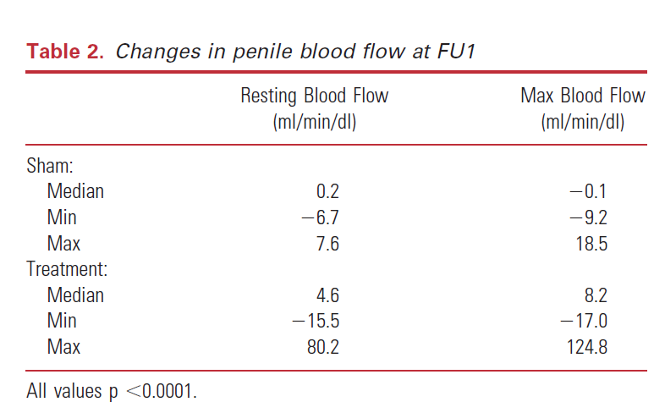

Slide 42
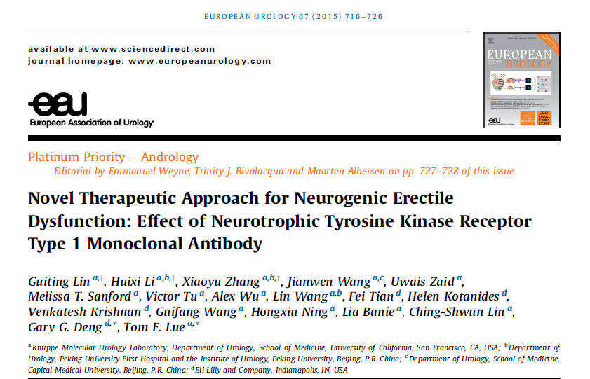

Slide 43
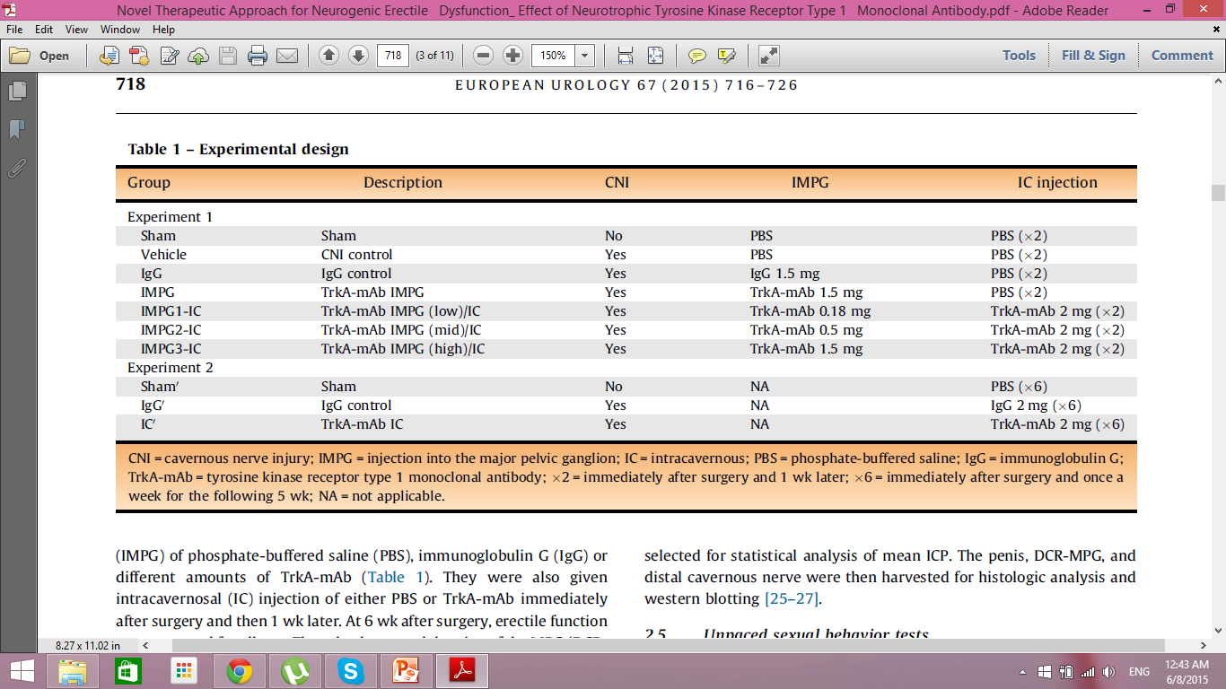

Slide 44
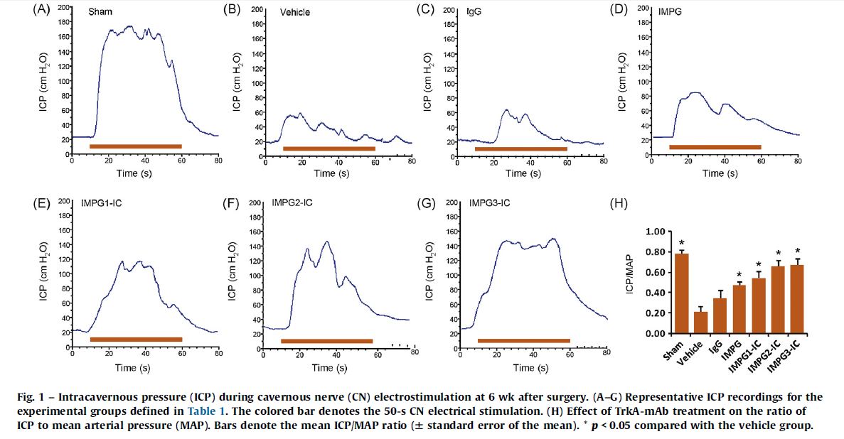

Slide 45
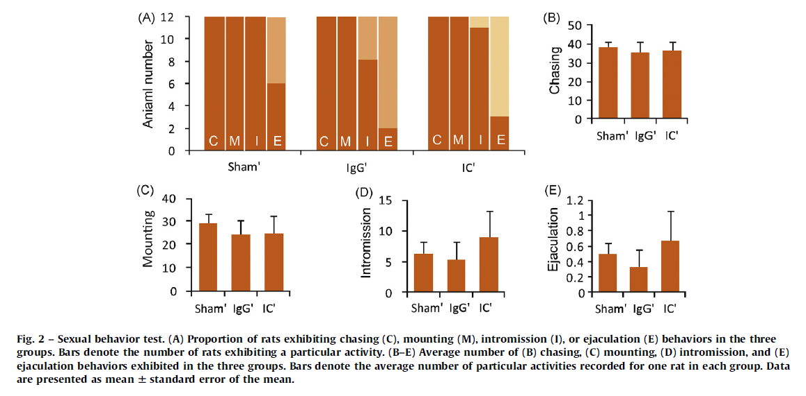

Slide 46
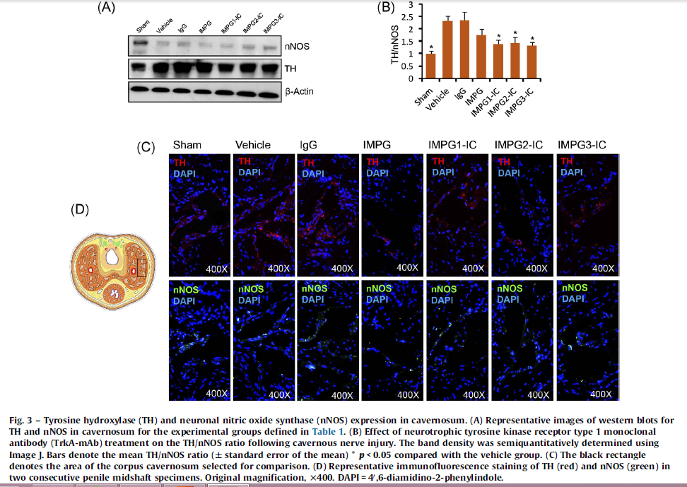

Slide 47
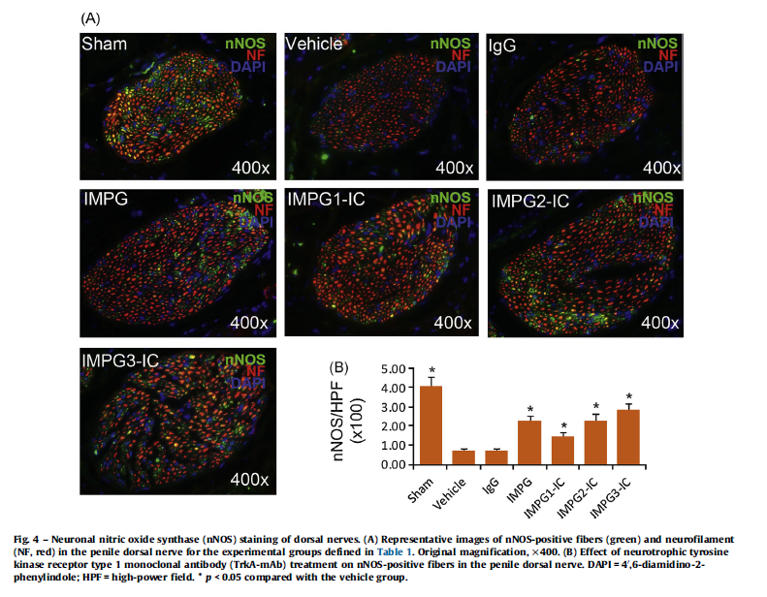

Slide 48
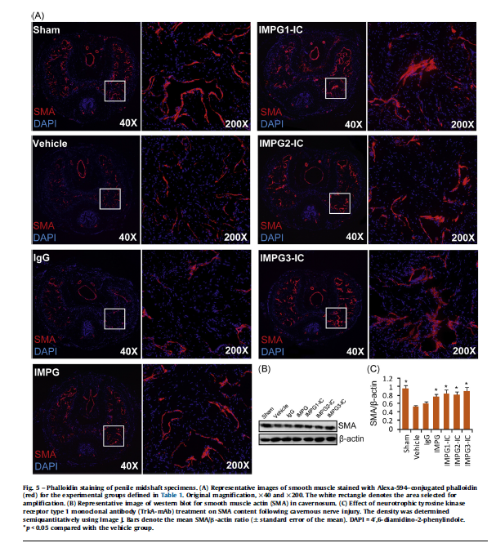

Slide 49


Slide 50


Slide 51


Slide 52


Slide 53


Slide 54


